Slide 1
Data Lake Onboarding

Slide 2
Sections
Links
Dev Tools
Cluster Architecture and Hadoop Tools
Permissions
HDFS Directory Structure
Working on an Edge Node
Troubleshooting and Common Issues

Slide 3
Links

Slide 4
Node Naming Scheme
polpcdhen001.corp.intranet
Cluster:
Node type: en, dn, kn, mn, …
Node number: 001, 002, 003, …
Dev Hue Server: poldcdhen001.dev.intranet:8889
Prod Edge Node 3: polpcdhen003.corp.intranet
Production | polp … corp
Disaster Recovery | pdlr … corp
Test (Continuous Integration) | polc … test
Development | pold … dev

Slide 5
Links
Hue:
https://polpcdhen001.corp.intranet:8889/
https://pdlrcdhen001.corp.intranet:8889/
https://polccdhen001.test.intranet:8889/
https://poldcdhen001.dev.intranet:8889/
Cloudera Manager:
https://polpcdhcm001.corp.intranet:7183
https://pdlrcdhcm001.corp.intranet:7183
https://polccdhcm001.test.intranet:7183
https://poldcdhcm001.dev.intranet:7183

Slide 6
Links (Continued)
Jupyter Hub:
https://polpcdhen005.corp.intranet:8000
https://poldcdhen005.dev.intranet:8000
Git Lab:
https://ne1itcprhas62.ne1.savvis.net/
Jenkins:
http://ne1itcprhas51:8088/

Slide 7
Dev Tools

Slide 8
Dev Tools (Need to Install)
Git:
https://git-scm.com/downloads
Visual interfaces (e.g. Source Tree) also exist.
Gradle:
Gradle Wrapper is in repository. No need for install.
ANT (We are moving away from this towards Gradle)
http://ant.apache.org/bindownload.cgi
http://ant-contrib.sourceforge.net/

Slide 9
Dev Tools (Need to Install) (Continued)
SSH Client:
https://cygwin.com/install.html
http://www.putty.org/
SFTP Client
https://filezilla-project.org/
https://winscp.net/eng/download.php

Slide 10
Dev Tools (Need to Install) (Continued)
Text Editors / IDEs
https://www.sublimetext.com/2
https://notepad-plus-plus.org/download/v7.4.1.html
https://eclipse.org/ (or Scala IDE – for Spark)
Python (May not be necessary, but useful)
https://www.continuum.io/downloads
https://www.python.org/downloads/
Oracle Database Client
Toad / PLSQL Developer / Oracle SQL Developer.
Can be obtained through https://ssapps/ESD

Slide 11
Cluster Architecture and Hadoop Tools

Slide 12
Cluster Architecture
Directly interface only with edge nodes.
Various tools will leverage other nodes.
HDFS
Sqoop
Flume/Kafka
Spark
Etc…

Slide 13
Dev HDFS Nodes
Edge1
Kafka1
Kafka2
Kafka3
Edge2
Data node 1
Data node ..
Data node 20
Edge3
Users
Management node 1
Management node 2
Management node 3
Edge4
Edge5
security node 1
security node 2
….
Coludera manager node 1
Coludera manager node 2
Edge9

Slide 14
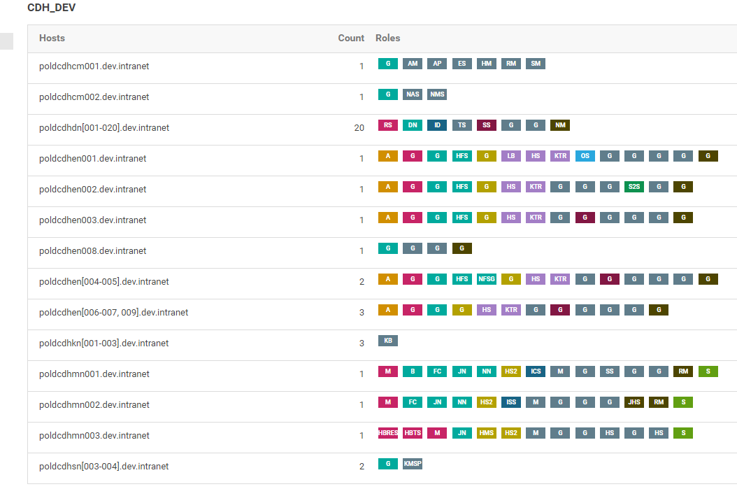
Dev HDFS Node roles
Dev cloudera manger roles link --- https://poldcdhcm001.dev.intranet:7183/cmf/hardware/roles#clusterId=1

Slide 15
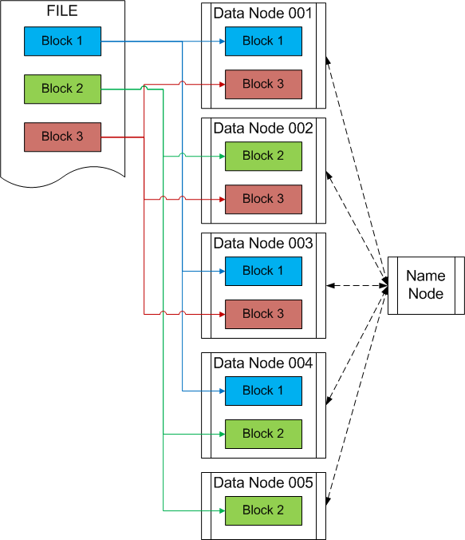
HDFS Architecture
Each file is broken into 128 MB blocks.
Each block is replicated 3-fold across data nodes.
If a node goes down, data is automatically replicated
The name node manages where each block can be found.

Slide 16
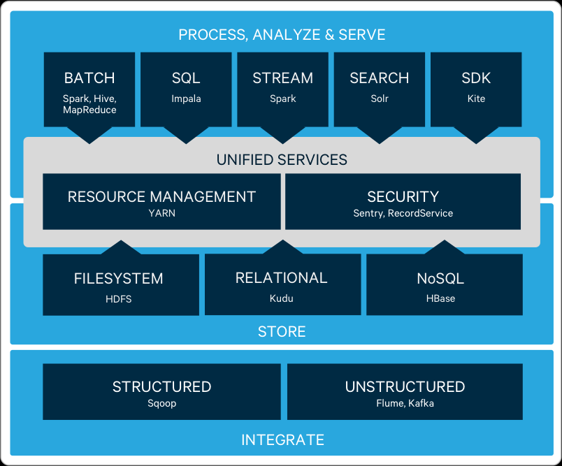
Cloudera Toolset

Slide 17
Cloudera Toolset Matrix
Tool Name | Used For | At what process level it is used
SQOOP | Structured Data | Integrate Data - mostly relational Databases
FLUME, KAFKA | Real-time Data | Integrate Data - mostly real-time Data streams
HDFS | File System | Storing Data- most of the time data is stored in this format
KUDU | Relational File System | Storing Data- less frequent, but if there is need for OLTP type data transaction available in hadoop, we store in this format
HBASE | NoSQL File system | Storing Data- less frequent, if the data is unstructured we can in this format
YARN | Resource Manager | Services Across Hadoop -- this is the one which manages hadoop/cloudera env, this is more like operating system for hadoop
SENTRY | Security | Services Across Hadoop -- this provides access and other security to hadoop
HIVE | SQL like querying data | PROCESSING
IMPALA | SQL like querying data | PROCESSING
SPARK | Stream, Analyze | PROCESSING-- vastly used for processing , analyzing data in batch/real time. Mostly this is like a programming tool
SOLR | SEARCH | This will provide data indexing and faster relation searches on data

Slide 18
Current Hadoop Tool Use
Tool | Current Use
HDFS | Through command line (hdfs dfs …) and behind the scenes.
YARN | Mainly logs, debugging. Used behind the scenes.
Oozie | Job scheduling, workflow creation.
Sqoop | Importing data from RDBMSs (Primarily Oracle). Sqoop actions in Oozie workflows.
Hive / Impala | Steps in Oozie workflows. One-off queries/tasks.
Spark | B2B Models. One-off queries/tasks.
Flume / Kafka | Real time streams. Example: netstats, syslogs, capm.
SOLR | For indexing and searching: EX: pdf search for marketing

Slide 19
Current Job Types
Job Type | Example Source | Description / Tools
API | Marketo | Scheduled via cron / bash scripts because of networking constraints. Kicks off Oozie workflow.
SFTP | Adobe, AW | Scheduled via cron / bash scripts because of networking constraints. Kicks off Oozie workflow.
RDBMS | OSR, B360, many others | Oozie coordinators / workflows. Sqoop/Hive/Impala.
Real Time | netstats, syslogs, capm | Flume or Flume+Kafka. Overlaid with Hive tables.
Models | Cross-Sell/Up-Sell | Oozie coordinators / workflows. Hive/Impala. Spark (Primarily Scala, though original code may be in Python/R).

Slide 20
Permissions

Slide 21
Data Lake Permissions
Centrify creates OS and HDFS users and groups based on Active Directory (AD) users and groups.
If granted edge node access, the username and password correspond to your AD username and password.
This means account passwords are the same across all environments, tools, and systems.
AD groups determine permissions. Groups control access to HDFS files, edge nodes and sudo access, tools, etc…
There are typically 3 versions of each group: One for each environment. (Prod and DR share the same permissions.) For example: cdlappgrpd, cdlappgrpc, cdlapgrpp.

Slide 22
Data Lake Permissions (Continued)
A common point of confusion is that there are two distinct file systems: the OS FS and HDFS.
A set of files may be in both places (code, for example). Be sure to clarify where something is!
HDFS has no concept of a working directory. Files will likely be in an absolute path format.
Files in HDFS can have different permissions from files on the OS.
Files in HDFS can also have access controlled by tools such as Sentry. This is common for database directories.
OS users must get a Kerberos ticket through kinit to interact with Hadoop services.

Slide 23
HDFS Directory Structure

Slide 24
Encrypted File Zone
Everything is currently under the encrypted file zone, /data/CTL/encrypt/. Files in this zone are transparently encrypted at rest and decrypted when accessed by an authorized user.
Default HDFS user directories (/user/cuid) are not in the encrypted file zone.
There are sometimes issues with tools when attempting to move data between the encrypted and unencrypted file zones.
Description of how this works (Each file has it’s own encrypted decryption key): https://www.cloudera.com/documentation/enterprise/5-10-x/topics/cdh_sg_hdfs_encryption.html

Slide 25
HDFS Directory Structure
HDFS Directory | Description
/user/cuid | Home directory for your cuid
/data/CTL/encrypt | Encrypted File Zone. The root of most other useful paths.
/data/CTL/encrypt/code/<app_id> | Code (primarily Oozie) for each team’s application user.
/data/CTL/encrypt/code/ingest | Code for the cdlapp user. Only for CoE Team.
/data/CTL/encrypt/pwd/<app_id> | Password files for each user. Example “/data/CTL/encrypt/pwd/cdlapp“
/data/CTL/encrypt/env/<app_id> | Currently contains a keytab. Could be used for other ‘environment’ files.
/data/CTL/encrypt/code/util/ | Master copies of process owned and maintained by Datalake Team. Non-Datalake teams needs to copy for usage. Currently contains files for Flume watchdog process. Could contain other utility files.

Slide 26
HDFS Directory Structure (Continued)
HDFS Directory | Description
/data/CTL/encrypt/db | Hive Databases. Sentry Controlled.
/data/CTL/encrypt/db/users/<user_id> | User Databases Hive user database is created on this data in HDFS. Example Hive database jwenzel on /data/CTL/encrypt/db/users/jwenzel
/data/CTL/encrypt/db/dept/<dept_name> | Department Databases. Department data. A Hive database will be created on the dept data in HDFS Example hdfs directory /data/CTL/encrypt/db/dept/marketsales/b2bmkt/dept_marketsales_b2bmktg, hive database is dept_marketsales_b2bmktg. Note sub-directories can be created to store model output, Solr index, etc for this dept. The <dept_name> hierarchy can contain data of different types.
/data/CTL/encrypt/db/entp/<entp_domain> | Enterprise Databases – Enterprise data. A Hive database will be created on the entp data in HDFS. A conceptual example would be data for network cards from multiple sources with network cards. No example in CDL.

Slide 27
HDFS Directory Structure (Continued)
HDFS Directory | Description
/data/CTL/encrypt/db/ingest/raw/<source_name> | Raw Ingestion Databases. Ingested source data in HDFS. Hive database is created on this data. With some minimal processing (adding partition, few metadata columns, etc.) when the ingested raw data can be consumed by downstream, Hive database will be named as <source_name> Example Hive database cdbi is created on /data/CTL/encrypt/db/ingest/raw/cdbi Note most of the sources currently in CDL are fall into this category. When the raw data needs to be further processed before consuming, the Hive database will be named as <source_name>_ingest to store the raw data and it served as a temporary staging area. A processed HDFS directory will be created to store the processed data /data/CTL/encrypt/db/ingest/processed/<source_name>. Note only few sources fall into this category. Example Hive database sfdc_ingest is created on /data/CTL/encrypt/db/ingest/raw/sfdc Note <source_name> should match MAL entry
/data/CTL/encrypt/db/ingest/processed/<source_name> | Processed source data in HDFS (Optional). Hive database is created on this data. Example Hive database sfdc is created on /data/CTL/encrypt/db/ingest/processed/sfdc.
/data/CTL/encrypt/db/processed/ | Not in use.

Slide 28
HDFS Directory Structure (Continued)
HDFS Directory | Description
/data/CTL/encrypt/data (unstructured) | Non-Database Files (unstructured), such as PDFs, Microsoft Office documents, compressed text files, etc. This mirrors the db directory structure to some extent.
/data/CTL/encrypt/data/dept | Department Data.
/data/CTL/encrypt/data/entp | Enterprise Data.
/data/CTL/encrypt/data/ingest | Ingestion Data.
/data/CTL/encrypt/data/ingest/raw/<source_name> | Raw Ingestion Data from <source_name> Example /data/CTL/encrypt/data/ingest/raw/aw
/data/CTL/encrypt/data/ingest/processed | Non-Hive data that has been processed after the “raw” ingestion.

Slide 29
Working on an Edge Node

Slide 30
Useful Scripts and Aliases
The cdlapp account on EN001 has a kti alias. This will perform the kinit command and should be the one of the first commands executed when logging on.
The cdlapp account on EN001 also has a color alias, which will color the prompt depending on the environment.
The cdlapp account on EN001 has aliases autobeeline and autoimpala. These will open the beeline (Hive) or impala-shell prompts already connected to the correct services.
(Check the .bash_profile and .bashrc files for the definitions, or use the which command.)

Slide 31
Useful Scripts and Aliases (Continued)
The ~/oozie folder contains many useful shell and python script for interacting with Oozie. You should look here if you need to:
Kill a job
Restart a job
Suspend or resume a job
Find a job via the command line.
Suspend all coordinators for a user. (And later resume them.)
The ~/impala_scripts directory also contains a script to refresh all tables in an impala database.

Slide 32
Uploading Files from a Developer Machine
Use an SFTP client to transfer files from your machine to your account on an edge node.
If using an application account without direct access:
Make sure the folders containing your files have at least 555 permissions.
sudo su - acctname to log into the application account. (You must be in the proper group.)
cp -R filedir newdir to copy the files and change the owner.
kinit (or kti alias) if you have not done so already.
Use the hdfs dfs -put command to upload the folders/files to the proper HDFS directory.

Slide 33
Adding a Password File
Log into the application account and kinit.
Create your password file in a text editor (Such as vi). You will not want to type the password on the terminal since it would be logged to bash history. So avoid something like echo “password” > src.passwd.
The file should contain a single line with the password. Any newlines or special characters will be interpreted as part of the password.
Use hdfs dfs –put to upload the passwd file to the proper /data/CTL/encrypt/pwd/appname directory.
Use hdfs dfs -chmod 600 to change the file permissions in HDFS.
Delete the password file from the local OS file system.

Slide 34
Manual Deployment of Oozie Jobs
If using a build tool (e.g. Gradle), build the code for the correct environment.
Upload the code to the application account on the edge node file system. When using a build tool, there may be a build folder that mirrors the source structure where you should put the code.
Upload the code to HDFS under the correct /data/CTL/encrypt/code/user directory.
Run oozie job -oozie __OOZIE_URL__ -config job.properties –run. __OOZIE_URL__ will change depending on the environment. The job may also have a deploy script you could run instead.
Note: The job.properties file is read from the local FS at the time your run the Oozie command.

Slide 35
Troubleshooting and Common Issues

Slide 36
Troubleshooting
If you are running an Oozie workflow, check logs in Hue.
These may vanish after a while. It is best to check soon after the job fails.
You can also get to the Oozie UI through Cloudera Manager and check logs from there.
For any job scheduled via YARN (e.g. MapReduce, Spark) you can check the YARN logs.
The link can be found through Cloudera Manager.
Try running the failing steps manually if possible. Sometimes this reveals more information that is obscured in the Oozie/YARN logs.
If all else fails, reach out to other developers or to IT-DATALAKE-ADM.

Slide 37
Common Issues
When on the edge node, make sure you have a valid Kerberos ticket, especially if getting an authentication or GSS error. You can use klist to check the current ticket, or simply kinit to request a new ticket.
If asked for a password when running sudo su - user, you may not be in the necessary group. Contact IT-DATALAKE-ADM.
When copy/pasting a URL, make sure it is for the correct cluster. The clusters cannot generally cross-talk. For example, if you submit an Oozie job with a URL for a different cluster the command will hang.
Oozie jobs launched from the command line as an application user need to be killed from the command line as the same application user.

Slide 38
Common Issues (Continued)
When working on a new Hive database, you need to ask IT-DATALAKE-ADM to create it before starting to create tables.
When creating external tables in Hive, there is sometimes an extra URI grant that is needed. If getting a permission issue, contact IT-DATALAKE-ADM.
When writing a Sqoop job for a new database type (i.e. not an Oracle database), make sure the necessary jar file exists. Contact IT-DATALAKE-ADM or other developers for help with this.

Slide 39
Common Issues (Job Memory)
Jobs sometimes need more memory to run. Here are some ways to allocate 8GB of memory to a job. You can increase this as necessary, but there is a cap. At a certain point jobs will schedule but not run as they wait to acquire unavailable resources. (Typically above 32GB.)
Hive: SET mapreduce.map.memory.mb=8192; SET mapreduce.map.java.opts=-Xmx8G;
Spark: spark-shell --driver-memory 8G --executor-memory 8G
Sqoop: -D mapreduce.map.memory.mb=8192 -D mapreduce.map.java.opts=-Xmx8192m

